Slide 1
Which 2 regions are known for growing apples?
Blue Ridge & Valley and Ridge
Coastal Plain & Piedmont
Piedmont & Appalachian Plateau
Blue Ridge & Coastal Plain

Slide 2
The Potomac River runs through—
Yorktown
Richmond
Alexandria
Fredericksburg

Slide 3
The James River is located on number—
1
2
3
4

Slide 4
Name the region that has this product.

Slide 5
Q: Which industry is known for its recreation industry?

Slide 6
What body of water provided transportation links between Virginia and other places (e.g., Europe, Africa, Caribbean)?
Atlantic Ocean
Chesapeake Bay
James River
York River

Slide 7
Which of the following is NOT true about the Chesapeake Bay?
It provided a safe harbor.
It was a source of transportation.
It is where many rivers in Virginia start.
It is a source of food.

Slide 8
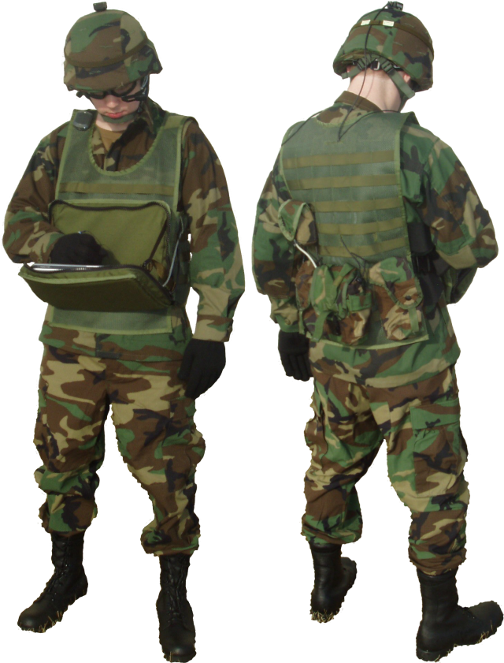
Name the region that has this industry.

Slide 9
The star shows—

Slide 10
Which of the following is true about the James, York, Rappahannock, and Potomac Rivers?
They all provide a border between Virginia and Maryland.
They all flow into the Chesapeake Bay.
They all are in northern Virginia.
They all go through Richmond.

Slide 11
Number 1 points to—

Slide 12
Q: Which region is known for its textiles industry?

Slide 13
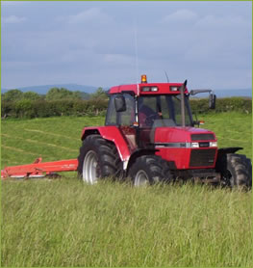
Name the regions that have this industry.

Slide 14
Q: Which region is known for its coal mining?

Slide 15
Richmond and Jamestown are located on the—
James River
York River
Rappahannock River
Potomac River

Slide 16
Yorktown is located along the—
Potomac River
Rappahannock River
York River
James River

Slide 17
The York River is located on number—
1
2
3
4

Slide 18
The Rappahannock River runs through—
Fredericksburg
Yorktown
Jamestown
Potomac

Slide 19
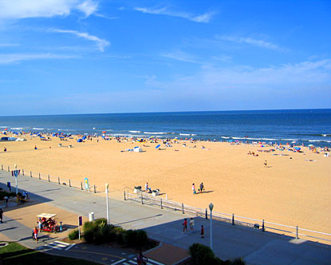
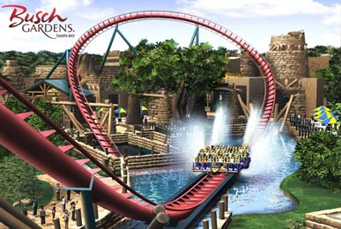
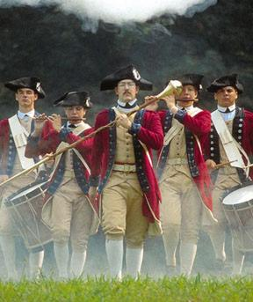
Name the region that has these tourist attractions.

Slide 20
Which of the following is NOT true about the rivers in Virginia?
They provided food.
They provided a pathway for exploration in Virginia.
People in Virginia did not like to settle on the rivers.
You cannot sail past a river’s Fall Line.

Slide 21
The triangle shows—

Slide 22
Name the colored part.

Slide 23
All of the following are true about the Eastern Shore EXCEPT—
It is a peninsula.
It is bordered by the Chesapeake Bay to the west.
It is bordered by the Atlantic Ocean to the east.
It is not a part of Virginia.

Slide 24
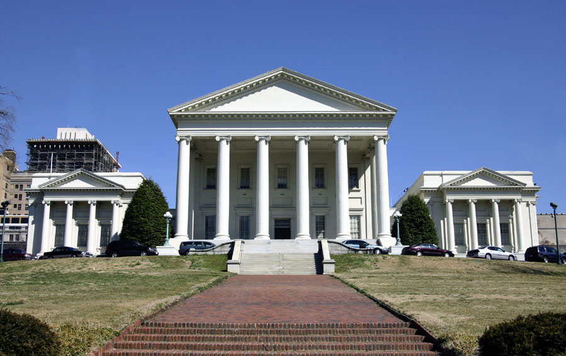
Name the region that has this industry.
Richmond Capitol Building

Slide 25
The arrow is pointing to—

Slide 26
What is a peninsula?
A piece of land bordered by water on three sides.
A body of water bordered by land on three sides.
An elevated piece of land with a flattened top.
A large land-mass.

Slide 27
Name the colored part.

Slide 28
Name the colored part.

Slide 29
Rivers flow—
Uphill to the mountains
Downhill to the sea
Around in a circular motion
Away from the center of the Earth

Slide 30
Which of the following is NOT true about the Fall Line?
It is the natural border between the Tidewater and Piedmont regions.
Many early Virginia cities developed along the Fall Line.
It is where the land rises sharply and where the waterfalls prevent further travel on the river.
The Fall Line for the Jamestown River is in the Blue Ridge Mountains.

Slide 31
Which region is known for its textile industry?
Coastal Plain
Piedmont
Blue Ridge
Valley and Ridge

Slide 32
Which region is known for its coal mining?
Piedmont
Blue Ridge
Valley and Ridge
Appalachian Plateau

Slide 33
Name the colored part.

Slide 34
Name the colored part.

Slide 35
Which region is known for its seafood?
Piedmont
Coastal Plain
Valley and Ridge
Appalachian Plateau

Slide 36
Name the colored part.

Slide 37
Name the colored part.

Slide 38
Which region is known for its shipbuilding?
Blue Ridge
Piedmont
Coastal Plain
Valley and Ridge

Slide 39
Which region is known for its tourism?
Coastal Plain
Piedmont
Blue Ridge
Appalachian Plateau

Slide 40
Which region is known for its federal military institutions?
Valley and Ridge
Blue Ridge
Appalachian Plateau
Coastal Plain

Slide 41
Which region is known for its tobacco products?
Valley and Ridge
Blue Ridge Mountains
Piedmont
Appalachian Plateau

Slide 42
Which region is known for its information technology?
Piedmont
Blue Ridge
Valley and Ridge
Coastal Plain

Slide 43
Name the colored part.

Slide 44
Name the colored part.

Slide 45
Which region is known for having federal and state governments?
Blue Ridge
Piedmont
Coastal Plain
Appalachian Plateau

Slide 46
Which 2 regions are known for farming?
Piedmont & Valley and Ridge
Piedmont and Blue Ridge Mountains
Coastal Plain & Appalachian Plateau
Blue Ridge & Valley and Ridge

Slide 47
Which region is known for its recreation industry?
Appalachian Plateau
Piedmont
Valley and Ridge
Blue Ridge

Slide 48
Which region is known for its poultry?
Piedmont
Blue Ridge
Valley and Ridge
Coastal Plain

Slide 49
Name the colored part.

Slide 50
Which river is the arrow pointing to?

Slide 51
The arrow is pointing to—

Slide 52
Which river is the arrow pointing to?

Slide 53
Which river is the arrow pointing to?

Slide 54
The arrow is pointing to—

Slide 55
Q: Which region is known for its poultry products?

Slide 56
The arrow is pointing to—

Slide 57
The arrow is pointing to—

Slide 58
Name the colored part.

Slide 59
Q: Many early Virginia cities developed on the what?

Slide 60
Q: Industries in Virginia produce what for the United States?

Slide 61
Q: Which region is known for its tourism industry?

Slide 62
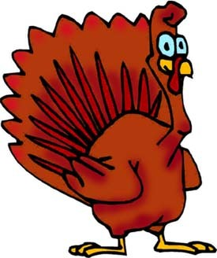
Name the region that has this product.

Slide 63
Q: What do you call the natural border between the Tidewater and Piedmont regions where the land rises sharply and where the waterfalls prevent further travel on the river?

Slide 64
Q: The four major rivers that flow into the Chesapeake Bay are separated by what?

Slide 65
Name the region that has this product.

Slide 66
Q: What separates the Eastern Shore from the mainland of Virginia?

Slide 67
Q: What is a piece of land bordered by water on three sides?

Slide 68
Q: What provided transportation links between Virginia and other places (e.g., Europe, Africa, Caribbean)

Slide 69
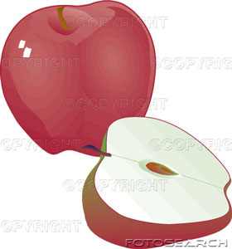
Name the regions that have this product.

Slide 70
Q: The cities of Richmond and Jamestown are located on which river?

Slide 71
Q: The city of Yorktown is located on which river?

Slide 72
Q: The city of Fredericksburg is located on which river?

Slide 73
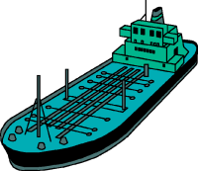
Name the region that has this product.

Slide 74
Q: The city of Alexandria is located on which river?

Slide 75
Q: All four of the major rivers in Virginia flow into the—

Slide 76
Q: Each river in Virginia was a source of what?

Slide 77
Q: What is the name of the peninsula bordered by the Chesapeake Bay to the west and the Atlantic Ocean to the east?

Slide 78
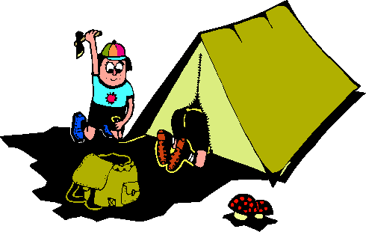
Name the region that has this industry. Hint: Camping is recreational.

Slide 79
Q: Which region is known for its seafood products?

Slide 80
Q: Which region is known for its shipbuilding industry?

Slide 81
Q: Which region is known for its federal military installations?

Slide 82
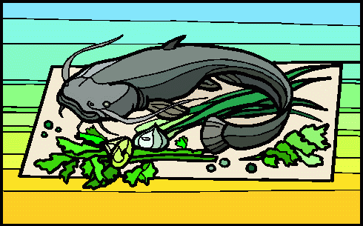
Name the region that has this product.

Slide 83
Q: Which region is known for its information technology products?

Slide 84
Q: Which region is known for its technology industry?

Slide 85
Q: Which region has federal and state government?

Slide 86
Q: Which two regions are known for farming?

Slide 87
Q: Which two regions are known for their apple products?

